Slide 1
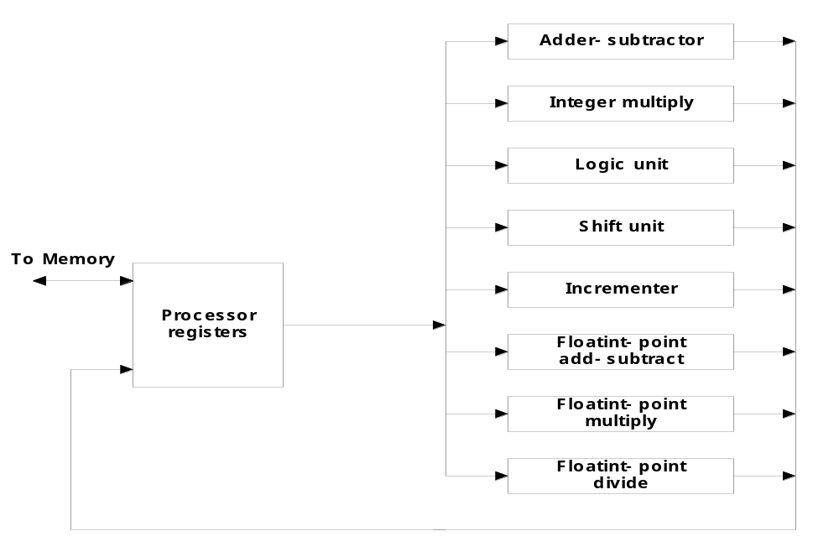
Chap. 9 Pipeline and Vector Processing
9-1 Parallel Processing
  Simultaneous data processing tasks for the purpose of increasing the computational speed
  Perform concurrent data processing to achieve faster execution time
  Multiple Functional Unit :
    Separate the execution unit into eight functional units operating in parallel
=
Parallel Processing Example

Slide 2
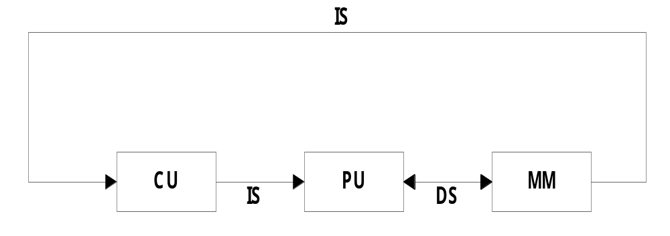
  Computer Architectural Classification
    Data-Instruction Stream : Flynn
    Serial versus Parallel Processing : Feng
    Parallelism and Pipelining : Händler
  Flynn’s Classification
  Instruction Stream: The sequence of instruction read from memory known as instruction stream.
  Data Stream: The operation perform on data in the processor known as data stream.
    1) SISD (Single Instruction - Single Data stream)
      for practical purpose: only one processor is useful
      Example systems : Amdahl 470V/6, IBM 360/91

Slide 3
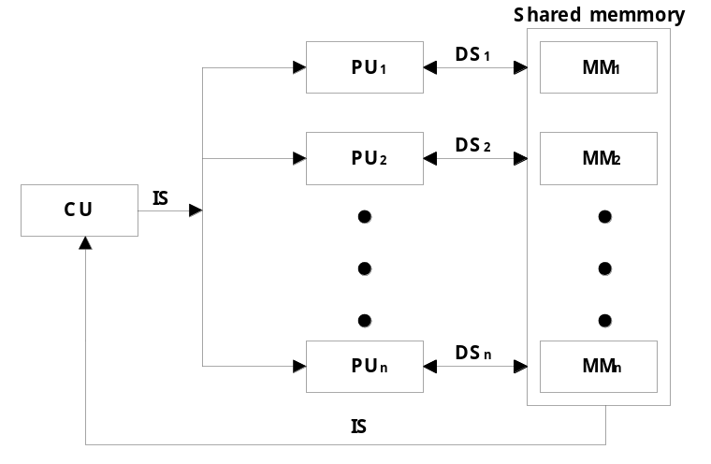
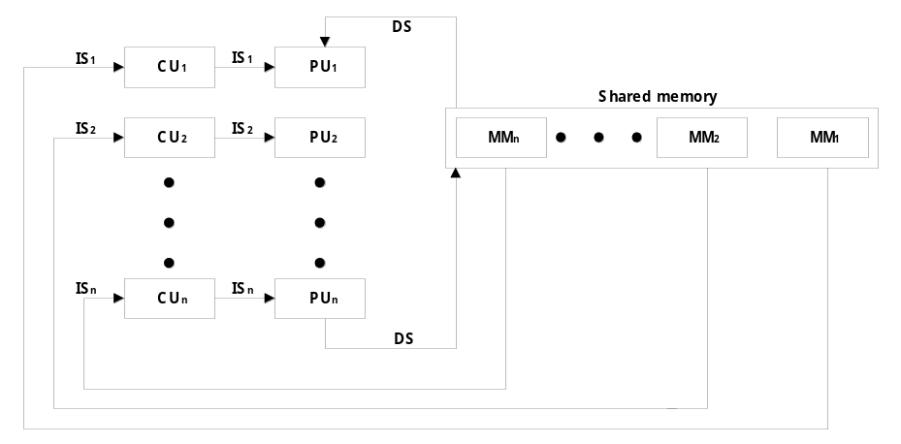
    2) SIMD
    (Single Instruction - Multiple Data stream)
      vector or array operations 에 적합한 형태
        one vector operation includes many operations on a data stream
      Example systems : CRAY -1, ILLIAC-IV
    3) MISD
    (Multiple Instruction - Single Data stream)
      Data Stream에 Bottle neck으로 인해
      실제로 사용되지 않음

Slide 4
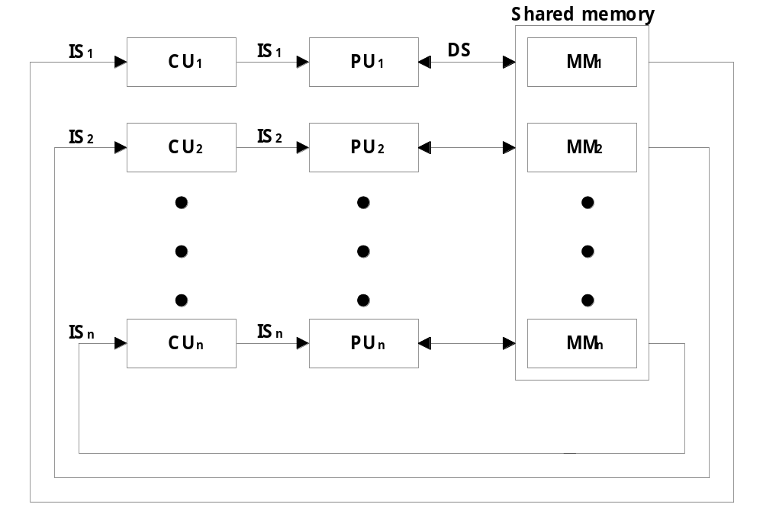
    4) MIMD
    (Multiple Instruction - Multiple Data stream)
      대부분의 Multiprocessor
      System에서 사용됨
  Main topics in this Chapter
    Pipeline processing : Sec. 9-2
      Arithmetic pipeline : Sec. 9-3
      Instruction pipeline : Sec. 9-4
    Vector processing :adder/multiplier pipeline 이용, Sec. 9-6
    Array processing :별도의 array processor 이용, Sec. 9-7
      Attached array processor : Fig. 9-14
      SIMD array processor : Fig. 9-15
Large vector, Matrices,
그리고 Array Data 계산

Slide 5

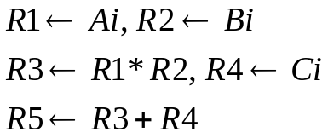
9-2 Pipelining
  Pipelining의 원리
    Decomposing a sequential process into suboperations
    Each subprocess is executed in a special dedicated segment concurrently
  Pipelining의 예제 : Fig. 9-2
    Multiply and add operation : ( for i = 1, 2, …, 7 )
    3 개의 Suboperation Segment로 분리
      1) : Input Ai and Bi
      2) : Multiply and input Ci
      3) : Add Ci
    Content of registers in pipeline example : Tab. 9-1
  General considerations
    4 segment pipeline : Fig. 9-3
      S : Combinational circuit for Suboperation
      R : Register(intermediate results between the segments)
    Space-time diagram : Fig. 9-4
      Show segment utilization as a function of time
    Task : T1, T2, T3,…, T6
      Total operation performed going through all the segment
Segment
versus
clock-cycle

Slide 6
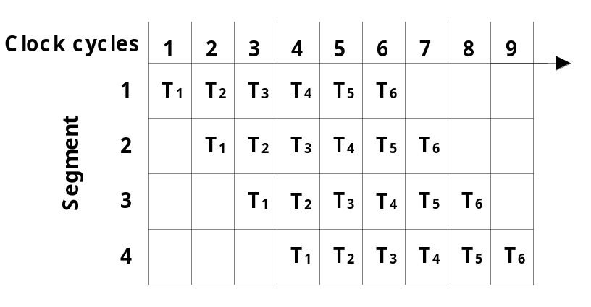
  Speedup S : Nonpipeline / Pipeline
    S = n • t_{n} / ( k + n - 1 ) • t_{p} = 6 • 6 t_{n} / ( 4 + 6 - 1 ) • t_{p} = 36 t_{n} / 9 t_{n} = 4
      n : task number ( 6 )
      t_{n} : time to complete each task in nonpipeline ( 6 cycle times = 6 t_{p})
      t_{p} : clock cycle time ( 1 clock cycle )
      k : segment number ( 4 )
    If n→ ∞ 이면, S = t_{n} / t_{p}
    한 개의 task를 처리하는 시간이 같을 때
    즉, nonpipeline ( t_{n} ) = pipeline ( k • t_{p} )
    이라고 가정하면,
    S = t_{n} / t_{p} = k • t_{p} / t_{p} = k
    따라서 이론적으로 k 배 (segment 개수)
    만큼 처리 속도가 향상된다.
  Pipeline에는 Arithmetic Pipeline(Sec. 9-3)과 Instruction Pipeline(Sec. 9-4)이 있다
Sec. 9-3 Arithmetic Pipeline
  Floating-point Adder Pipeline Example : Fig. 9-6
    Add / Subtract two normalized floating-point binary number
      X = A x 2ª = 0.9504 x 10³
      Y = B x 2^{b} = 0.8200 x 10²
Pipeline에서의 처리 시간 = 9 clock cycles
k + n - 1 ≈ n

Slide 7
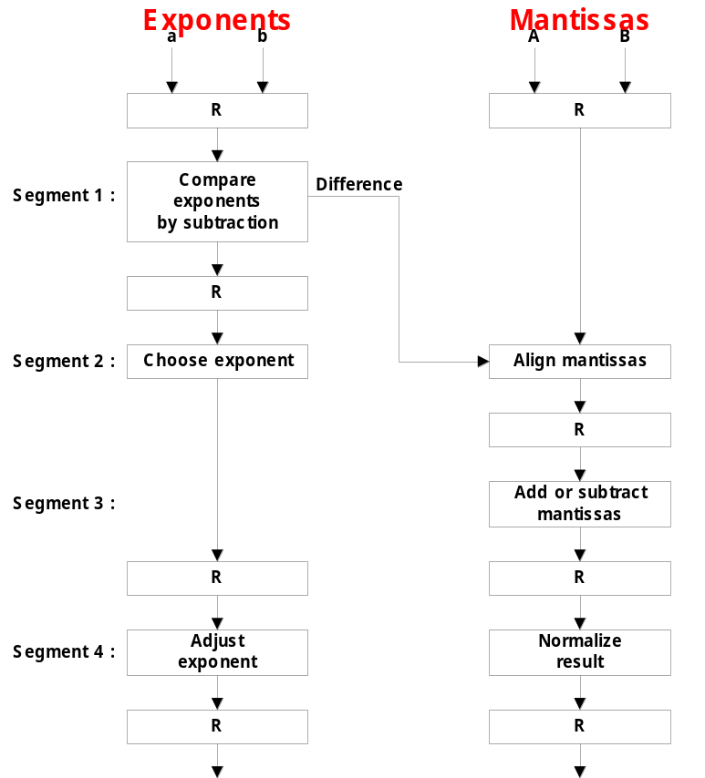
    4 segments suboperations
      1) Compare exponents by subtraction :
      3 - 2 = 1
        X = 0.9504 x 10³
        Y = 0.8200 x 10²
      2) Align mantissas
        X = 0.9504 x 10³
        Y = 0.08200 x 10³
      3) Add mantissas
        Z = 1.0324 x 10³
      4) Normalize result
        Z = 0.1324 x 10⁴

Slide 8
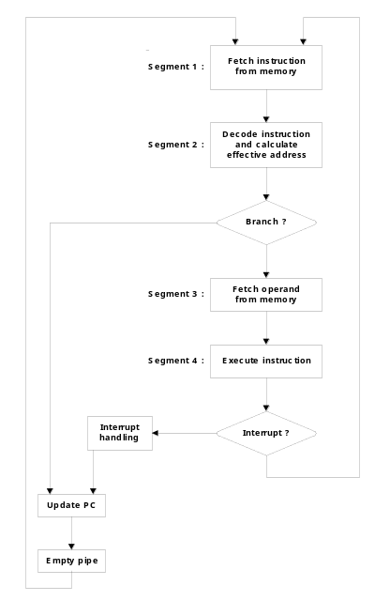
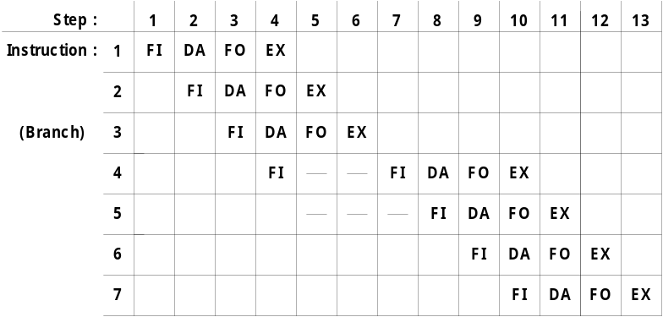
9-4 Instruction Pipeline
  Instruction Cycle
    1) Fetch the instruction from memory
    2) Decode the instruction
    3) Calculate the effective address
    4) Fetch the operands from memory
    5) Execute the instruction
    6) Store the result in the proper place
  Example : Four-segment Instruction Pipeline
    Four-segment CPU pipeline : Fig. 9-7
      1) FI : Instruction Fetch
      2) DA : Decode Instruction & calculate EA
      3) FO : Operand Fetch
      4) EX : Execution
    Timing of Instruction Pipeline : Fig. 9-8
      Instruction 3 에서 Branch 명령 실행
No Branch
Branch

Slide 9
  Pipeline Conflicts : 3 major difficulties
    1) Resource conflicts
      memory access by two segments at the same time
    2) Data dependency
      when an instruction depend on the result of a previous instruction, but this result is not yet available
    3) Branch difficulties
      branch and other instruction (interrupt, ret, ..) that change the value of PC
  Data Dependency 해결 방법
    Hardware 적인 방법
      Hardware Interlock
        previous instruction의 결과가 나올 때 까지 Hardware 적인 Delay를 강제 삽입
      Operand Forwarding
        previous instruction의 결과를 곧바로 ALU 로 전달 (정상적인 경우, register를 경유함)
    Software 적인 방법
      Delayed Load
        previous instruction의 결과가 나올 때 까지 No-operation instruction 을 삽입
  Handling of Branch Instructions
    Prefetch target instruction
      Conditional branch에서 branch target instruction (조건 맞음) 과 다음 instruction (조건 안 맞음) 을 모두 fetch

Slide 10
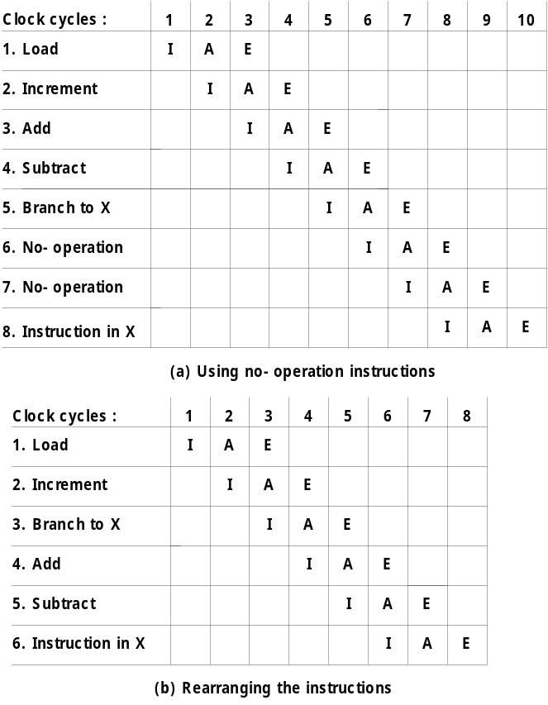
    Branch Target Buffer : BTB
      1) Associative memory를 이용하여 branch target address 이후에 몇 개에 instruction 을 미리 BTB에 저장한다.
      2) 만약 branch instruction이면 우선 BTB를 검사하여 BTB에 있으면 곧바로 가져온다(Cache 개념 도입)
    Loop Buffer
      1) small very high speed register file (RAM) 을
      이용하여 프로그램에서 loop를 detect한다.
      2) 만약 loop가 발견되면 loop 프로그램 전체를
      Loop Buffer에 load 하여 실행하면 외부
      메모리를 access 하지 않는다.
    Branch Prediction
      Branch를 predict하는 additional hardware logic 사용
  Delayed Branch 해결 방법
    Fig. 9-8 에서와 같이 branch instruction이
    pipeline operation을 지연시키는 경우
    예제 : Fig. 9-10, p. 318, Sec. 9-5
      1) No-operation instruction 삽입
      2) Instruction Rearranging : Compiler 지원

Slide 11
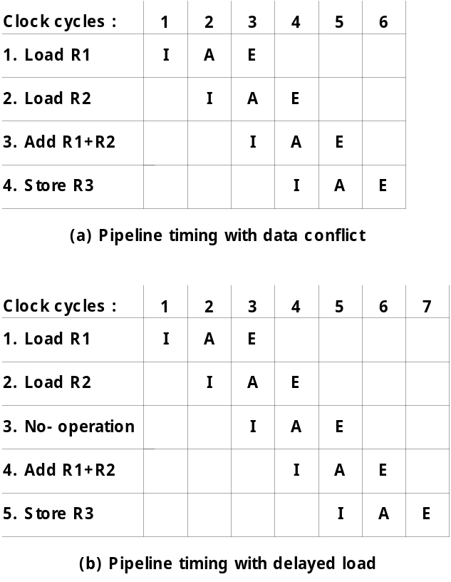
9-5 RISC Pipeline
  RISC CPU 의 특징
    Instruction Pipeline 을 이용함
    Single-cycle instruction execution
    Compiler support
  Example : Three-segment Instruction Pipeline
    3 Suboperations Instruction Cycle
      1) I : Instruction fetch
      2) A : Instruction decoded and ALU operation
      3) E : Transfer the output of ALU to a register,
      memory, or PC
    Delayed Load : Fig. 9-9(a)
      3 번째 Instruction(ADD R1 + R3)에서 Conflict 발생
        4 번째 clock cycle에서 2 번째 Instruction (LOAD R2)
        실행과 동시에 3 번째 instruction에서 R2 를 연산
      Delayed Load 해결 방법 : Fig. 9-9(b)
        No-operation 삽입
    Delayed Branch : Sec. 9-4에서 이미 설명
Conflict 발생

Slide 12
9-6 Vector Processing
  Science and Engineering Applications
    Long-range weather forecasting, Petroleum explorations, Seismic data analysis, Medical diagnosis, Aerodynamics and space flight simulations, Artificial intelligence and expert systems, Mapping the human genome, Image processing
  Vector Operations
    Arithmetic operations on large arrays of numbers
    Conventional scalar processor
      Machine language
    Vector processor
      Single vector instruction
      Fortran language
Initialize I = 0
20 Read A(I)
Read B(I)
Store C(I) = A(I) + B(I)
Increment I = I + 1
If I ≤ 100 go to 20
Continue
DO 20 I = 1, 100
20 C(I) = A(I) + B(I)
C(1:100) = A(1:100) + B(1:100)

Slide 13
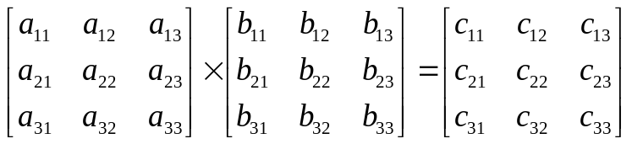



  Vector Instruction Format : Fig. 9-11
  ADD A B C 100
  Matrix Multiplication
    3 x 3 matrices multiplication : n² = 9 inner product
      : 이와 같은 inner product가 9 개
    Cumulative multiply-add operation : n³ = 27 multiply-add
      : 이와 같은 multiply-add가 3 개
      따라서 9 X 3 multiply-add = 27
① ② ③
① ② ③
C₁₁의 초기값 = 0

Slide 14

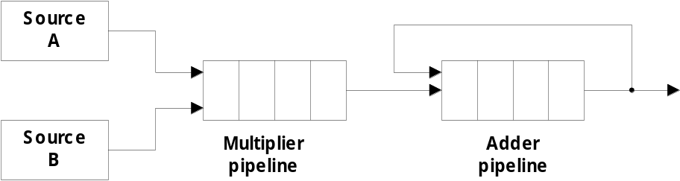
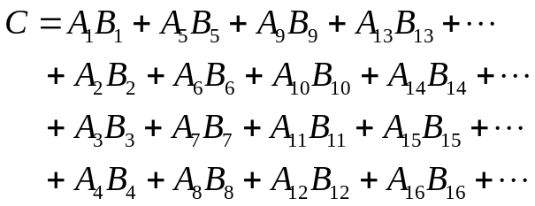


  Pipeline for calculating an inner product : Fig. 9-12
    Floating point multiplier pipeline : 4 segment
    Floating point adder pipeline : 4 segment
    예제 )
      after 1st clock input
      after 8th clock input
      Four section summation
      after 4th clock input
A₁B₁
A₄B₄ A₃B₃ A₂B₂ A₁B₁
      after 9th, 10th, 11th ,...
A₈B₈ A₇B₇ A₆B₆ A₅B₅ A₄B₄ A₃B₃ A₂B₂ A₁B₁
A₈B₈ A₇B₇ A₆B₆ A₅B₅ A₄B₄ A₃B₃ A₂B₂ A₁B₁
, , , ⑩ ⑨

Slide 15
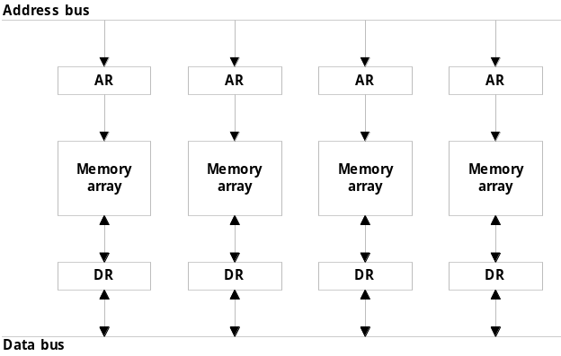
  Memory Interleaving : Fig. 9-13
    Simultaneous access to memory from two or more source using one memory bus system
    AR 의 하위 2 bit를 사용하여 4 개중 1 개의 memory module 선택
    예제 ) Even / Odd Address Memory Access
  Supercomputer
    Supercomputer = Vector Instruction + Pipelined floating-point arithmetic
    Performance Evaluation Index
      MIPS : Million Instruction Per Second
      FLOPS : Floating-point Operation Per Second
        megaflops : 10⁶, gigaflops : 10⁹
    Cray supercomputer : Cray Research
      Clay-1 : 80 megaflops, 4 million 64 bit words memory
      Clay-2 : 12 times more powerful than the clay-1
    VP supercomputer : Fujitsu
      VP-200 : 300 megaflops, 32 million memory, 83 vector instruction, 195 scalar instruction
      VP-2600 : 5 gigaflops

Slide 16
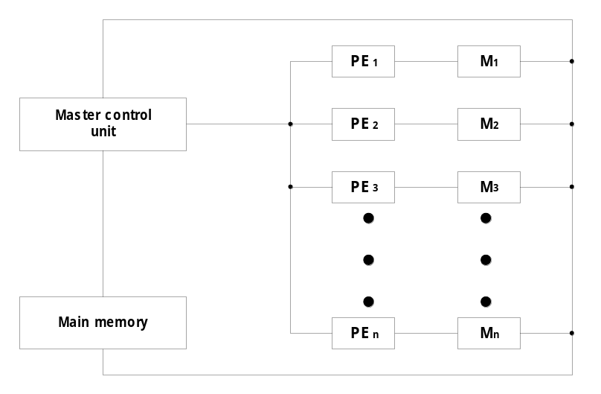
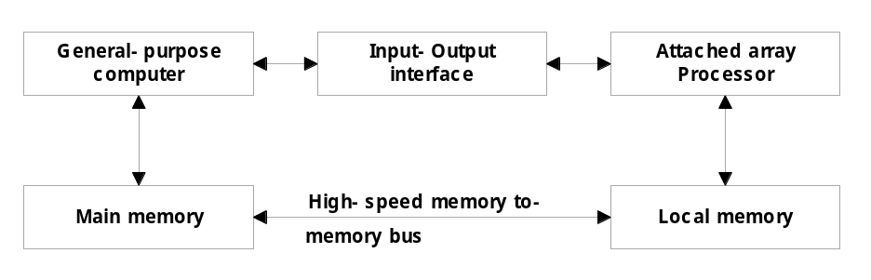
9-7 Array Processors
  Performs computations on large arrays of data
  Array Processing
    Attached array processor : Fig. 9-14
      Auxiliary processor attached to a general purpose computer
    SIMD array processor : Fig. 9-15
      Computer with multiple processing units operating in parallel
        Vector 계산 C = A + B 에서 c_{i} = a_{i} + b_{i} 를
        각각의 PE_{i}에서 동시에 실행
    Vector processing : Adder/Multiplier pipeline 이용
    Array processing :별도의 array processor 이용

